Slide 1
AIT-580 Final project
Shwetha Srinivasan Natesan

Slide 2
Provider Relief Fund COVID-19 Nursing Home Quality Incentive Program
This research aims to investigate the funds provided for the people in hospitals across the U.S affected by the corona virus during pandemic in the year 2020 based on three acts passed namely the bipartisan CARES Act, the Paycheck Protection Program and Health Care Enhancement Act (PPPHCEA), and the Coronavirus Response and Relief Supplemental Appropriations (CRRSA) Act.
Totally the amount collected was $178 billion dollars and this was given to the hospitals and other health care providers. From this around $2 billion dollar was allocated by the Department of Health and Human Services to nursing home facilities that helped to reduce both Covid 19 infection rates relative their county and the mortality rates against a national benchmark through the Health Resources and Service Administration.

Slide 3
RESEARCH QUESTIONS
The research questions include,
What are the characteristics of these acts which provided funds?
How was the infection rate measured and what are the measures taken to reduce it?
What are roles performed by the health care providers and how was the fund utilized to reduce the mortality rate?
What was the solution obtained from the Infection Rate and the Mortality rate based on the QIP funding?
Based on these questions the funding amount can be compared and the performance period can also be analyzed.

Slide 4
METHODS
The Provider Relief Fund COVID-19 Nursing Home Quality Incentive Program was available online to the public and it was provided by the Health Resources and Services Administration.
The dataset consists of 33,440 data values and 15 columns. Each row represents the Nursing Home Facility and the funding that occurred between September 2020 to December 2020. The size of the dataset is around 3930 KB which is equal to 3.93 MB, which is not quite large, but it was easier to load.
The tools used to analyze and visualize this dataset are R, Python and SQL. R is primarily used to do visualization because it was more efficient with the help of the ggplot function. In Python few visualizations and more statistical summaries were done.
The NOIR datatypes are Facility Name, City, State, Performance Month and Zip code are Nominal, the Infection Performance Score and Total Resident Weeks are Ratio, the Certification Number is Ordinal, and the Mortality Adjustment is Interval.
The SQL was implemented in the MY SQL Workbench version 8.0 to load the data and perform few queries.

Slide 5
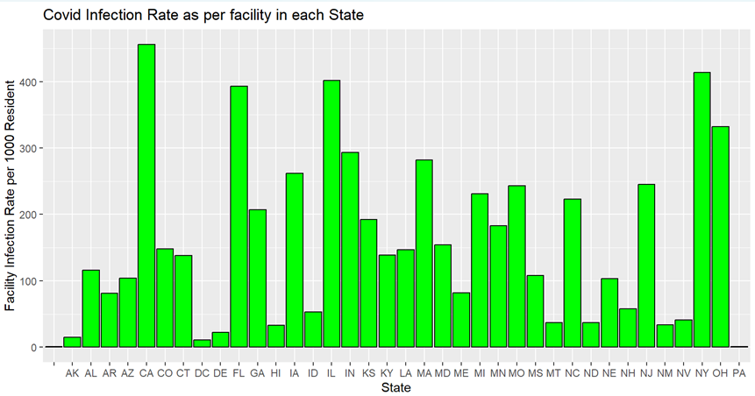
VISUALIZATION
The COVID Infection Rate as per the facility resident in each state is plotted using R and it observed that the California has the highest infection rate.

Slide 6
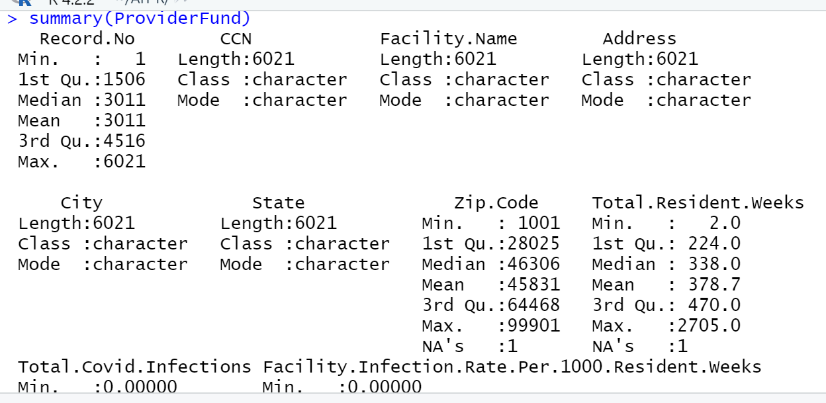
The summary of the dataset is done using R and we can see the minimum, maximum values for each column.
The mortality rate and infection rate are directly proportional as the mortality rate and infection rate are lower, then the funding provided would be calculated.

